Slide 1
Understanding and coping with loneliness
OR
How loneliness can fuck you up.
By Bill Coleman PhD (www.bcoleman.ca)

Slide 2
REVIEW OF LAST PRESENTION

Slide 3
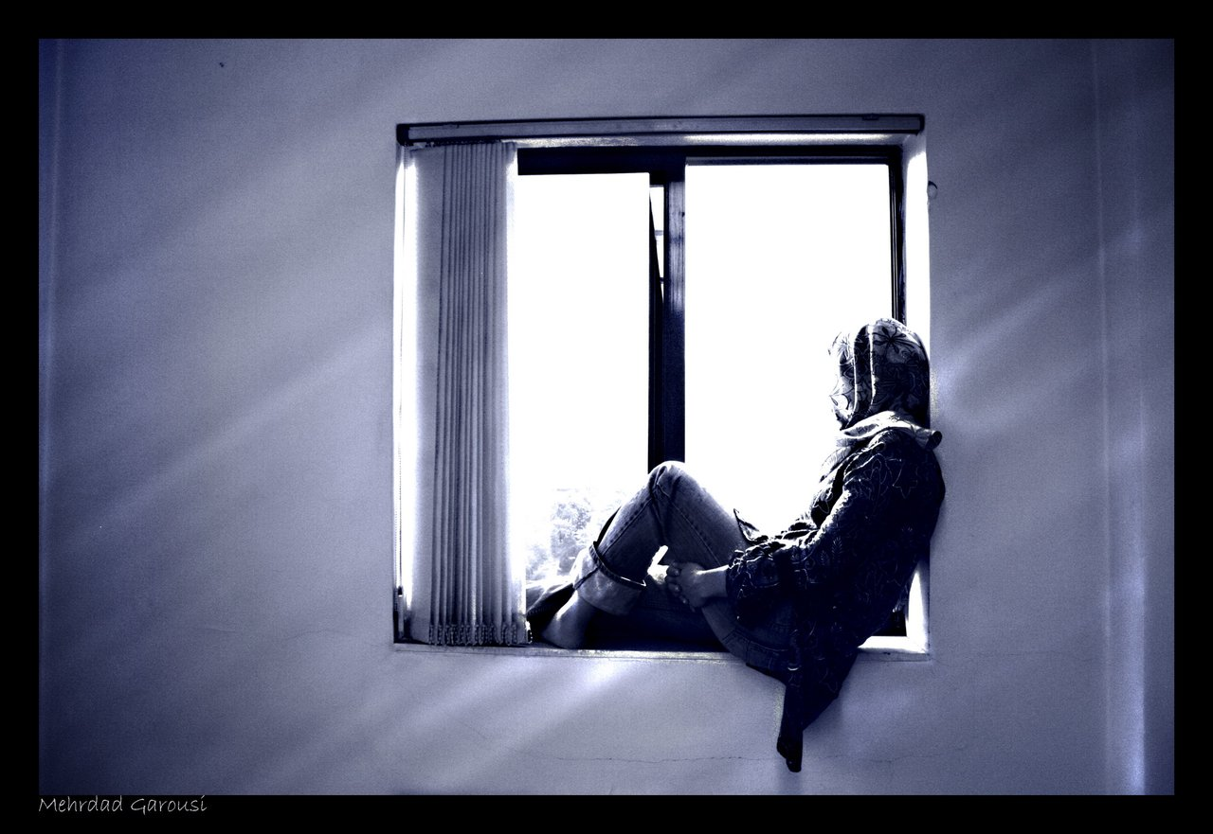
. HIV and Hep C can cause isolation and loneliness

Slide 4
Having HIV or Hep C can cause one to avoid being close to others and cause isolation. Fear of rejection because of HIV, can cause isolation.
Loneliness and isolation can
make it hard to have friends
and have an active sexual life.

Slide 5
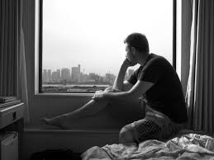
Loneliness and isolation can lead to depression which can lead to increased drug use.
Which can lead to loneliness and isolation.

Slide 6
What is loneliness and Isolation?

Slide 7
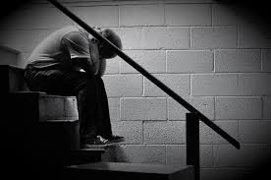
Loneliness is a common human emotion. It is, however, a complex and unique experience to each individual.
Up to 40% of Americans
say they are lonely.
Loneliness has no
single cause, but HIV
and Hep C can be
one cause of loneliness .

Slide 8
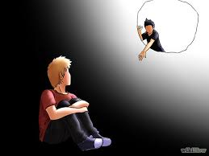
You can have dozens of "friends" and still feel lonely.
True intimacy and feelings of being connected are much more important than the quantity of friends.
Having at least one close
friend is important.

Slide 9
Mistakes Lonely People Often Make
They hide from the world because they're embarrassed about being lonely and having no life
They become experts at distracting themselves from their loneliness
They get too comfortable in their rut
They expect other people take all the
initiative in inviting them out
They think they have to be super
likable to have friends
They actually aren't that interested in
hanging around people
They have a negative attitude
towards people

Slide 10
The loneliness from the loss of a friend or boyfriend does not have to last long.
New relationships
usually are formed...
unless you've fallen
into a way of thinking
that keeps relationships
from forming.
Fear of rejection because of HIV/Hep C can cause isolation.

Slide 11
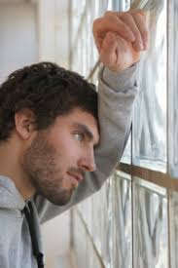
Persistent loneliness is emotionally painful.
Persistent loneliness can be
more damaging to our
physical and mental health
than many psychiatric
illnesses.
Persistent loneliness is harmful, and may have a negative effect on HIV/Hep C status.

Slide 12
Lonely people often have experienced more loss or trauma than others.
Being gay can cause guy to
Withdraw as a kid.
Lonely people often have
had a childhood spent
with negative, critical
and harsh parenting.

Slide 13
Lonely people remember their
parents as being disagreeable,
remote, and untrustworthy.
The loneliest people of all were
those whose parents had divorced.

Slide 14
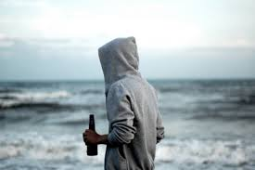
The Effects of Loneliness.

Slide 15
Lonely people sleep poorly.
Lonely people experience severe depression and anxiety.
Lonely people have reduced immune and cardiovascular functioning. This can cause problems for HIV/Hep C positive persons.
Lonely people exhibit signs of early cognitive decline that grows more severe over time.

Slide 16
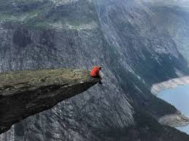
Lonely people frequently feel:
That they are disliked
Self-obsessed
A lack of empathy with others
Lonely gay guys may fear rejection and keep themselves at a distance, which feeds the loneliness. Having HIV/Hep C can cause additional fear of rejection.

Slide 17
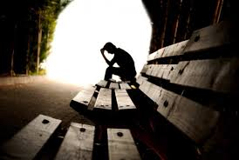
Lonely gay guys consume more drugs/alcohol and get less exercise than those who are not lonely.
Lonely gay guys have:
A diet higher in fat
Restless sleep that is
less efficient
Report more daytime
fatigue
Loneliness also disrupts the regulation of cellular processes deep within the body, predisposing us to premature aging.

Slide 18
Lonely gay guys pay more attention to negative interactions (like disagreements or criticism).
Lonely gay guys remember more of the negative things that happened during an encounter with another person, and fewer positive things. Being HIV+ or Hep C+ can cause one to have a negative view of the world.
The angry/bitchy guy may just be lonely for a long time and they are expecting bad things to happen.

Slide 19
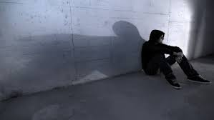
Loneliness has a wide range of negative effects on both physical and mental health. Some of the health risks associated with loneliness include:
Depression and suicide
Cardiovascular disease and stroke
Increased stress levels
Decreased memory and learning
Antisocial behavior
Poor decision-making
Alcohol and drug use
The progression of Alzheimer's disease
Altered brain function

Slide 20
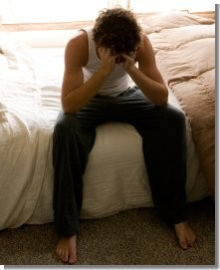
A lonely gay guy may feel:
Anger
Sadness
Depression
Worthlessness
Resentment
Emptiness
Vulnerability
Pessimism

Slide 21
Lonely people frequently feel that they are disliked, are often self-obsessed and lack empathy with others.
They fear rejection and keep
themselves at a distance,
which feeds the loneliness.
Don’t let HIV or Hep C make
You more lonely.

Slide 22
Over time, loneliness makes us increasingly sensitive to rejection.
Over time, loneliness
makes us on the lookout
for rejection and hostility.
Over time, HIV/Hep C
makes us on the lookout
for rejection and hostility.

Slide 23
Long term loneliness leads to more negative expectations about future interactions with others.
Lonely gay guys don't
expect things to go
well for them, and
consequently, things
often don't go well.

Slide 24
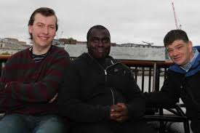

Slide 25
What works? What helps? The answer is clear.
Interventions aimed at changing negative thinking patterns are most effective in reducing loneliness. (This is not always easy.)

Slide 26
More than anything else, the cure for persistent loneliness lies in breaking the negative cycle of thinking, that created it in the first place.

Slide 27
Think about ways you can be of service to others in need.
By finding a way to help others, your own emotional needs will often be met and it will help you to cure loneliness in a big way.
The act of doing a good deed pushes out lonely feelings and opens the door to feeling more connected with others and creates a sense of belonging and attachment.
In touching someone’s life, our loneliness dissipates and this opens new doors of opportunity and connection.

Slide 28
Volunteer with organizations that do good work in your community.
Check into one or two groups and get involved.
Offer your time. You’ll meet lots of people who are trying to make a difference.
And just one new friend may make a difference in your life . . . and help you to cure your loneliness!

Slide 29
Commit to something, like drawing, painting, a hobby, a person.
Volunteer somewhere that involves being in constant contact with other people. Try sharing some of your time with others by visiting someone in a hospital or a retirement home or food bank etc.

Slide 30
If that doesn’t appeal to you, find another issue that you’re passionate about.
The more you volunteer in social environments, the more people you will meet and the better you will feel about your own circumstances.

Slide 31
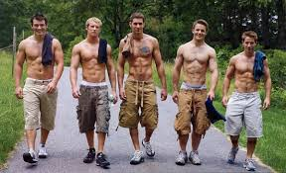
Look for potential friends. If you’re getting out on a regular basis, then you’ve started to come into contact with some of the same people. This can often be others who are HIV positive or Hep C positive.
You may enjoy spending
time together talking,
laughing etc.

Slide 32
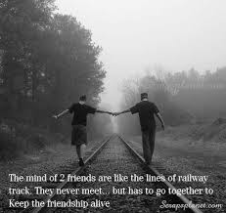
Once you get a chance to spend some quality time with people, find the people with whom you feel the most connected.
Share some personal
information or life
opinions and if they
reciprocate, you
are on your way to
build a deeper,
lasting friendship.

Slide 33
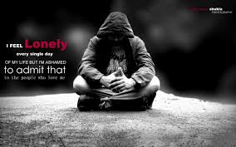
The biggest disease today is not cancer or tuberculosis, HIV or Hep C, but rather the feeling of being unwanted, uncared for and deserted by everybody.

Slide 34
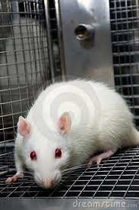
A study was done where they put a single rat in a cage, with two water bottles.
One bottle contained just water.
The other is water laced
with heroin or cocaine.
Almost every time they ran this experiment, the rat became obsessed with the drugged water and kept coming back for more and more, until it killed itself.

Slide 35
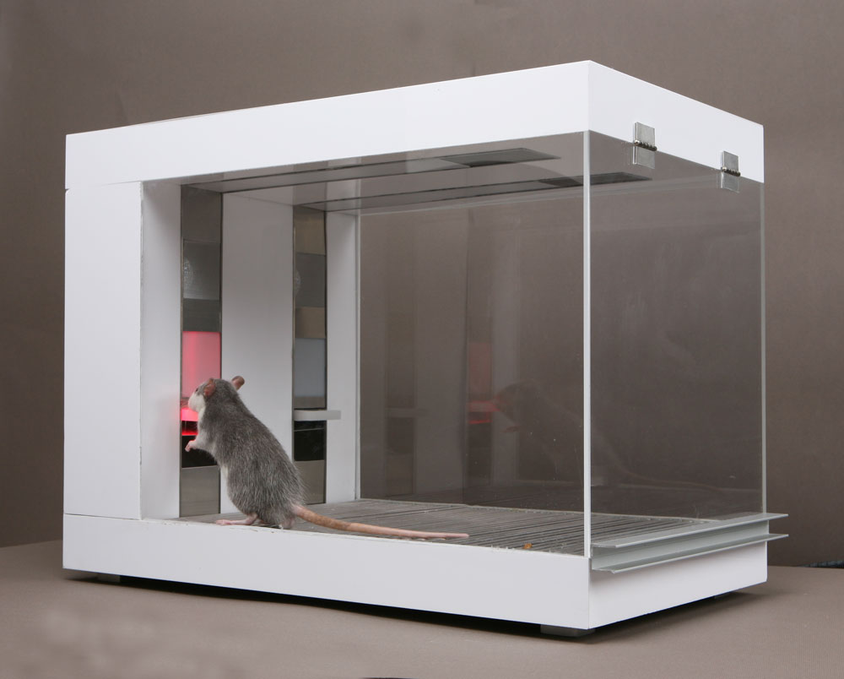
The experiment with lonely rats, who like coke and heroin can teach us a lot about loneliness and drug use!

Slide 36
Bruce Alexander, a professor of Psychology in Vancouver noticed something odd about this experiment.
The rat is put in the cage all alone. It has nothing interesting to do but take drugs.
He wondered, what would happen if we tried this differently?

Slide 37
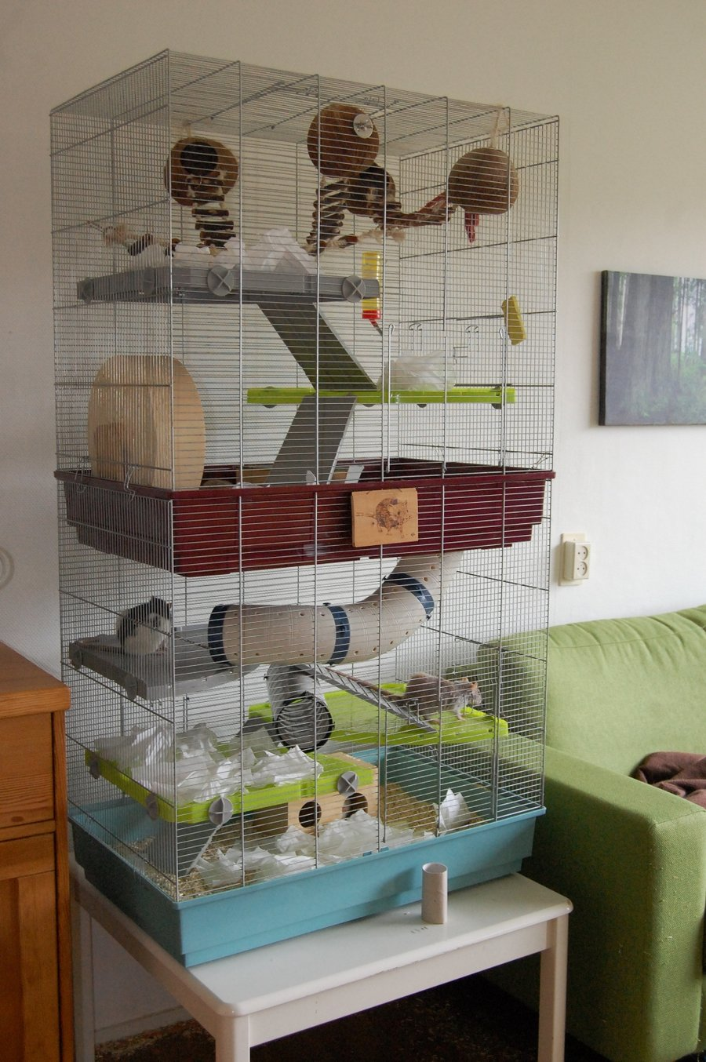
So he built a Rat Park.
It is a lush cage where the rats would have coloured balls and rat-food and tunnels to scamper down and plenty of rat friends to play with.
They had everything a rat about town could want.
Dr. Alexander wanted to know, how a rat in the Rat Park would react to heroin.

Slide 38
In the Rat Park, all the rats obviously tried both water bottles, because they didn't know what was in them. But what happened next was a surprise.
The rats with fun social lives didn't like the drugged water. They mostly shunned it, consuming less than a quarter of the drugs the isolated rats used. None of them died.
All the rats who were alone and unhappy became heavy users. None of the rats who had a fun social environment became a heavy drug user.

Slide 39
After the first phase of Rat Park, Dr. Alexander then took this test further.
He re-ran the early experiments, where the rats were left alone, and became compulsive users of the drugs. He let them use the drugs for fifty-seven days -- if anything can hook you, it's that.
Then he took them out of isolation, and placed them in Rat Park with friends. He wanted to know, if you fall into that state of addiction, is your brain hijacked, so you can't recover? Do the drugs take you over?

Slide 40
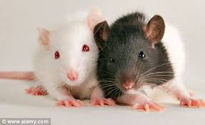
What happened is important to examine.
The rats seemed to have a few twitches of withdrawal, but they soon stopped their heavy use, and went back to having a normal life.
The social fun cage saved them. They sometimes enjoyed the drugs but it did not control them.

Slide 41
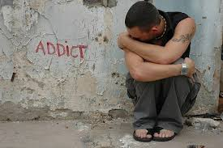
“If you believe that addiction is caused by chemical hooks, this makes no sense.
But if you believe Bruce Alexander's
theory, the picture falls into place.
The [street-addict] is like the rat in the first cage, isolated, alone, with only one source of solace to turn to.”
http://www.theguardian.com/commentisfree/2014/feb/17/loneliness-report-bigger-killer-obesity-lonely-people
Loneliness is killing us – we must start treating this disease
A report says loneliness is more deadly than obesity – the challenge now is to help lonely people connect Philippa Perry theguardian.com, Monday 17 February 2014

Slide 42
Professor Peter Cohen argues that human beings have a deep need to bond and form connections.
It's how we get our satisfaction. If we can't connect with each other, we will connect with anything we can find -- the whirr of a roulette wheel or the prick of a needle. He says we should stop talking about 'addiction' altogether, and instead call it 'bonding.
A heroin addict has bonded with heroin because s/he couldn't bond as fully with anything else.

Slide 43
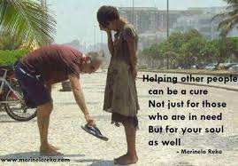
How to decrease loneliness
and adapt better to HIV
and Hep C.
Volunteer
Change negative thinking
Take risks to talk to others more
Believe in yourself and (some) others
Work at finding a friend
Go for long walks
Find your passion like art, helping others etc.
Believe you have something to offer to others

Slide 44
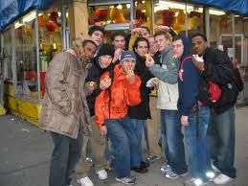
Relax and enjoy being with others.
HIV and Hep C does not have to lead to loneliness.

Slide 45
Bill Coleman PhD
bcxca@yahoo.com
www.bcoleman.ca

Slide 46
http://www.psychologytoday.com/blog/the-science-success/201010/the-cure-loneliness
The Science of Success
How we can all achieve our goals
by Heidi Grant Halvorson, Ph.D. The Cure for Loneliness
http://psychology.about.com/od/psychotherapy/a/loneliness.htm
Loneliness Causes, Effects and Treatments for Loneliness
By Kendra Cherry Psychology Expert
http://www.huffingtonpost.com/johann-hari/the-real-cause-of-addicti_b_6506936.html?fb_action_ids=10152977391675491&fb_action_types=og.likes
Johann Hari
Author of 'Chasing The Scream: The First and Last Days of the War on Drugs'
The Likely Cause of Addiction Has Been Discovered, and It Is Not What You Think
http://www.peplaulab.ucla.edu/Peplau_Lab/Publications_files/Rubinstein_Shaver_Peplau_79.pdf
LONELINESS
Almost everyone is lonely sometimes, but this common feeling arises not from a person's circumstance,
but from how he decides to interpret his situation.
CARIN RUBINSTEIN, PHILLIP SHAVER, AND LETITIA ANNE PEPLAU

Slide 47
http://www.livestrong.com/article/66458-cure-loneliness/
How to Cure Loneliness
Last Updated: Feb 08, 2014 | By Christa Miller
http://www.theguardian.com/commentisfree/2014/feb/17/loneliness-report-bigger-killer-obesity-lonely-people
Loneliness is killing us – we must start treating this disease
A report says loneliness is more deadly than obesity – the challenge now is to help lonely people connect Philippa Perry theguardian.com, Monday 17 February 2014
http://www.ncbi.nlm.nih.gov/pmc/articles/PMC3890922/
Indian J Psychiatry. 2013 Oct-Dec; 55(4): 320–322.
Loneliness: A disease? Sarvada Chandra Tiwari
http://www.succeedsocially.com/lonely
Succeed Socially .com
A free guide to getting past social awkwardness

Slide 48
http://www.besthealthmag.ca/best-you/mental-health/5-ways-to-beat-loneliness
5 ways to beat loneliness
Loneliness can affect us all at different times, in different ways. Whether it's a fleeting feeling or a constant state of disconnection, here are five ways to beat loneliness By Meredith Dault
http://www.slate.com/articles/health_and_science/medical_examiner/2013/08/dangers_of_loneliness_social_isolation_is_deadlier_than_obesity.html
Loneliness Is Deadly Social isolation kills more people than obesity does—and it’s just as stigmatized.By Jessica Olien

